Slide 1
Survivorship What comes after the match?
August 26, 2021

Slide 2
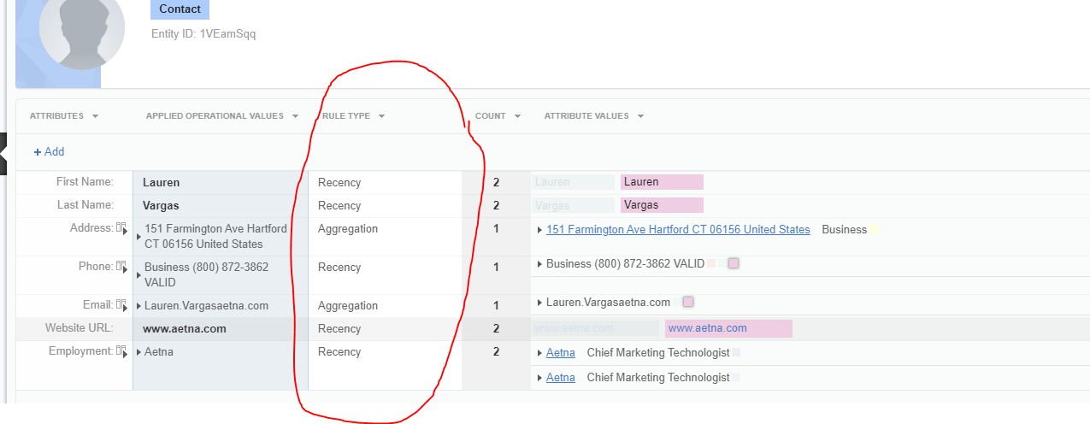
What is Survivorship
The rules governing how the operational value (OV) is selected between the values provided across the contributing source systems
In Reltio survivorship is…
Rules based
Calculated On the Fly
UI Customizable
Notes:
Survivorship is what comes after the match. It’s not enough to bring duplicate records together, you must also consider how to bring them together

Slide 3
Rule Types
Source System
Frequency
Recency
Survivorship Rules
Aggregate
Reltio Cleanser Or Nothing
Other Attribute Winner
Min Value
Oldest Value
Max Value

Slide 4
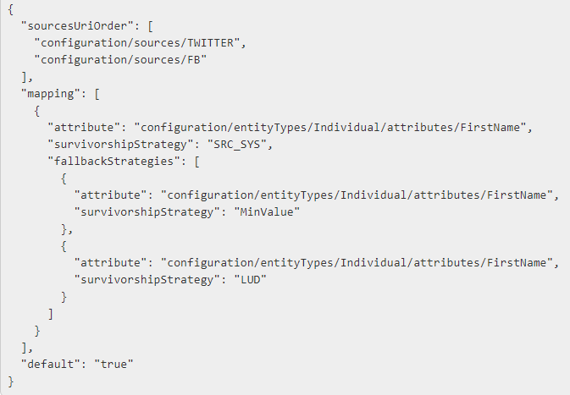
Fallback Strategies
Fall back strategies are needed to manage scenarios where survivorship is unable to choose a winner. In this case you can apply a backup strategy.

Slide 5
Pin and Ignore
Pining an attribute allows you to override survivorship
Ignoring and attribute allows you remove an attribute From being considered by survivorship

Slide 6
Tools and Resources
Postman
JSON Editor Online
Survivorship Docs
Out of the Box Data Model

Slide 7
Questions?

