Slide 1
Rule Based Matching
Deep Dive
August 19, 2021
Suchen Chodankar - Sr. Product Manager

Slide 2
Discussion Topics
Matching Overview
Match Rule Anatomy
Matching Process
Overview
Tokenization
Comparison
Configuration Examples

Slide 3
Match Best Practices - Summary
Match Rule Life Cycle
Data analysis and profiling
Design & Implementation
Testing & Tuning
Data analysis and profiling
Select match attribute based on the profiling results
Uniqueness, completeness and cardinality of attribute and how it should drive the configuration for optimal matching outcome
Design & Implementation
Tokenization Rule - IgnoreInToken
Optimal Token intersection and token count
Testing & Tuning
VerifyMatch API for troubleshooting
Match Rule Analysis for verifying the correctness & completeness of the configuration

Slide 4
Questions
Is there any performance implication of having redundant match rules?
Do we run rebuild only when the match rules are changed?
What other match related jobs we need to be aware of?
How undermatching or overmatching is related to tokenization?
Is there any limitation on the number of match rules we can configure for any entity?

Slide 5
Matching Overview
Matching is a process of identifying records that are same or related to each other
Reltio platforms supports 2 methods of matching
Rule based matching
Machine learning based matching
Supported Match Actions
Automatic Merge - System triggered action
Mark as “not a match” - User triggered action
Potential Duplicate Record for Review - Suspect [Merge]
Potential Related Record for Review - Suspect [Relate]
Publish Matched Pairs - System triggered action

Slide 6
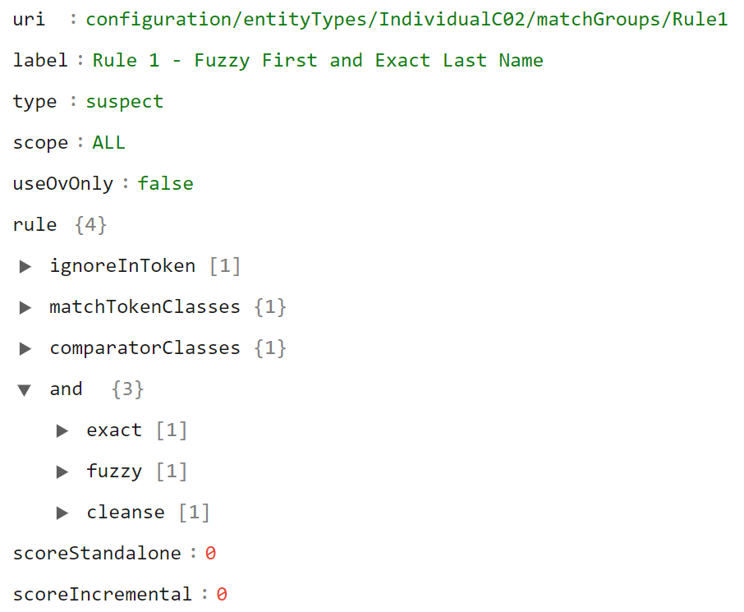
Match Rule Anatomy
Rule Label / Display Name
action to execute on the match pairs
Scope of Matching
inclusive/exclusion of non-OV value
Token phrase generation logic
Comparison function Definition
Match Comparison Instructions
Match Cleanse Functions
Entity Match Degree

Slide 7
Match Rule Anatomy - Continue..
Match Rule Configuration
Automatic Merge
Matching Logic
Match Type
Match Action
Suspect Match
Publish Match
Set of instructions used to identify matches
Drives what action is taken on the matched pair
Cleanse Rules
Tokenization Rules
Comparison Rules
Binary Outcome Based
Relevance Based Actions
Custom Type

Slide 8
Match Troubleshooting/Tuning APIs
/services/reltio/tools/matching/matchTokenClasses
/services/reltio/tools/matching/comparatorClasses
/services/reltio/tools/matching/matchTokens
/services/reltio/tools/matching/matchTokenIntersections
/services/reltio/tools/matching/compare
/services/reltio/api/{tenantId}/entities/_verifyMatches
/services/reltio/api/{tenantId}/entities/{id}/matchDocument
/services/reltio/api/{tenantId}/entities/{id}/matchTokens
/services/reltio/api/{tenantId}/entities/{id}/matchTokensDetailed

Slide 9
Examples

Slide 10
Matching Process Overview
Reltio UI
Primary
Match Document
Analytics
Rule Configurations
Automerges
Potential Matches
Publish Match Pairs
Data Load
Data Store
Attribute Values
Cleanse/OV Status
Token Phrases
Match Pairs
Other Services
Changed?
CRUD Queue
Match Queue
Match Document Processor
Matching
Match Service

Slide 11
Data Tokenization Process
Tokenization Rules
Token Phrases
 | Record
First Name | Michael
Last Name | Branson
Address Line 1 | 1450 Tommy Dr
City | Wilmington
State | IL
Zip Code | 60481
T1
T2
Michael:Branson:1450 2nd St:Wilmington:IL
T3
Tokenization Attributes
T4
Branson:1450 2nd St:Wilmington:IL
(ignoredInToken - FirstName)
...
Tn
Michael:1450 2nd St:Wilmington:IL
(ignoredInToken - LastName)
Mike:Branson:1450 2nd St:Wilmington:IL (synonymName)
Default Rule: value{Attr-1}:value{Atr-2}:<More Attributes>
Attributes excluded from tokenization automatically if rule uses below operators
ExactOrNull
ExactOrAllNull
NotEquals
In

Slide 12
Data Tokenization Process - Continue..
Token Phrase [Bucket]
E1
E2
E9
E7
E4
E3
Smith:Richmond:VA
Tokenization Rules
E5
E3
E1
T1
E2
E4
E6
Ei
Ei
T2
E9
E8
E7
Ei
Ei
Ei
T3
Ei
Ei
Ei
Ei
Ei
T4
Ei
Ei
Ei
Ei
...
Tn
Entities
Tokenization
Token Phrases

Slide 13
Data Comparison Process
Match Candidate List
Match Rules
Matched Pairs
Match Action
E1
E2
E9
Rule 1
E1
E3
Auto-Merge
E7
E3
E2
Config
Action
E1
E7
E4
E3
System
Rule 2
E1
E1
E4
Config
Action
E1
E2
E8
E7
E1
E4
Suspect for Review
.
.
.
.
E8
E1
E8
E1
E9
Data Steward
E1
E9
Rule n
E9
Config
Action
E4
E3
E1
E4
E8

Slide 14
Tokenization Scenarios
 | Record 1 | Record 2 | Record 3 | Record 4 | Record 5 | Record 6
First Name | Michael | Mikel | Michael | Michael | Michael | Rachel
Last Name | Branson | Branson | Branson | Branson | Branson | Branson
Address Line 1 | 1450 Tommy Dr | 1450 Tommy Dr | 1450 Tom Dr | 1450 Tommy Dr | 6611 Danton St | 1450 Tommy Dr
City | Wilmington | Wilmington | Wilmington | Wilmington | Wilmington | Wilmington
State | IL | IL | IL | Illinois | NC | IL
Zip Code | 60481 | 60481 | 60481 | 60481 | 28412 | 60481
Tokenization Attributes
1
2
3
4
Michael:Branson:1450 Tommy Dr:Wilmington:IL
Branson:1450 Tommy Dr:Wilmington:IL
Branson:Wilmington:IL
Branson:Wilmington

Slide 15
Tokenization Issues
Excessive number of tokens for an entity
Example 1: Fuzzy matching on more than one multi-values attributes
Example 2: Fuzzy matching on attribute in combination with synonym matching
Excessive number of entities sharing a token phrase
Example 1: Too many entities share the same set of attribute values for different attributes
Example 2: Multiple duplicate copies of the profiles from the source systems

Slide 16
Examples

Slide 17
Example

Slide 18
Match Rules
 | Rule 1 | Rule 2 | Rule 3 | Rule 4 | Rule 5
Rule Type | Suspect | Suspect | Suspect | Relevance Based | Custom Type
First Name | Exact | Fuzzy | Fuzzy | Fuzzy
Middle Name |  | Exact |  | Exact
Last Name | Exact | Exact | Fuzzy | Exact | Exact
Address Line 1 | Exact | Exact | Exact | Exact | Exact
City | Exact | Exact | Exact | Exact | Exact
State | Exact | Exact | Exact | Exact | Exact
Zip Code | Exact | Exact | Exact | Exact | Exact
Tokenization Attributes

Slide 19
Thank you!

